Slide 1
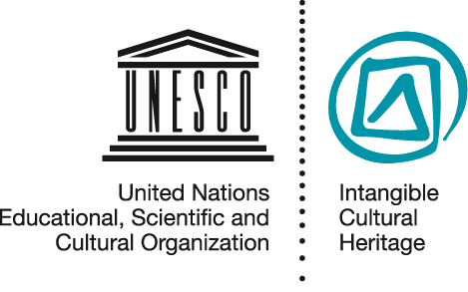
Introducing the Intangible Heritage Convention
IMP 5.2
UNESCO
Intangible Cultural Heritage Section

Slide 2
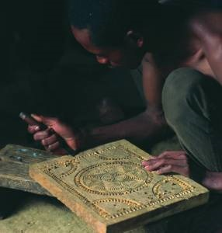
In this presentation…
UNESCO and its conventions
The Intangible Heritage Convention
Objectives
Governing organs
Two Lists and a Register
Operational Directives
The Fund
Obligations and benefits
The Woodcrafting Knowledge of the Zafimaniry, © J. Ségur/ZED
Notes:
http://www.unesco.org/culture/ich/index.php?lg=en&pg=00011&RL=00080

Slide 3
UNESCO and its Conventions
Inter-governmental organisation with 193 member states
Education, sciences, culture and communication
7 UNESCO conventions in the area of culture and heritage
tangible, intangible and natural heritage
diversity of cultural expressions
copyright

Slide 4
Three related UNESCO Conventions
Convention concerning the Protection of the World Cultural and Natural Heritage (1972)
Convention for the Safeguarding of the Intangible Cultural Heritage (2003)
Convention on the Protection and Promotion of the Diversity of Cultural Expressions (2005)

Slide 5
Comparing two Conventions
World Heritage (1972)
Intangible Heritage (2003)
Conservation of immovable heritage and places
Cultural and/or natural
Outstanding universal value
Authenticity, integrity help to define value, often limiting change
Safeguarding of expressions, skills, practices, knowledge
Cultural and/or social
Communities define value
People enact and transmit: ICH changes over time and different practitioners may enact differently

Slide 6
Comparing two Conventions
Diversity of Cultural Expressions (2005)
Intangible Heritage (2003)
Cultural activities, goods and services (products)
Cultural expressions often new, individual creations
Focus on cultural industries, dissemination and development
Skills, practices, expressions, knowledge
ICH is a collective practice, transmitted from “generation” to “generation”
Focus on safeguarding practice and transmission of ICH

Slide 7
The Intangible Heritage Convention
Preamble
Objectives (Art.1)
Definitions (Art.2)
Governing organs (Art.4-8)
Safeguarding – national (Art.11-15)
Lists and Register (Art.16-18)
International cooperation and assistance (Art.19-28)
Reporting (Art.29-30)
Ratification etc. (Art.32-33)

Slide 8
Objectives of the Convention
Article 1
Safeguarding
Respect
Awareness and mutual appreciation
International cooperation and assistance

Slide 9
Two Lists
USL: Urgent Safeguarding List (article 17)
RL: Representative List
(article 16)

Slide 10
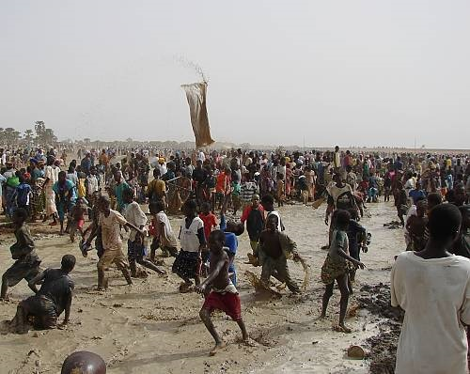
The Sanké mon: collective fishing rite of the Sanké
The Sanké mon collective fishing rite takes place annually in the Ségou region of Mali to mark the beginning of the rainy season and commemorate the founding of the town San.
In recent years, fewer people attend the rite, because of decreasing awareness of its function and history, occasional accidents and the degradation of the Sanké Lake
© Direction nationale du patrimoine culturel, Ministère de la culture du Mali
Notes:
http://www.unesco.org/culture/ich/index.php?lg=en&pg=00011&USL=00289

Slide 11
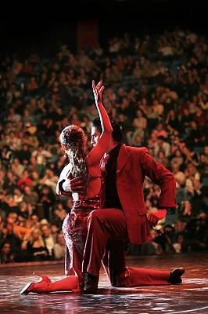
The Tango
The Tango is a symbol of the popular culture of Argentina and Uruguay, especially their capital cities. Originating in working class neighbourhoods of Buenos Aires, the Tango dates back to the late nineteenth century. Practiced spontaneously or in more formal settings, it enjoys great popularity locally and worldwide.
© 2008, by Ministerio de Cultura Ciudad de Buenos Aires
Notes:
http://www.unesco.org/culture/ich/index.php?lg=en&pg=00011&RL=00258

Slide 12
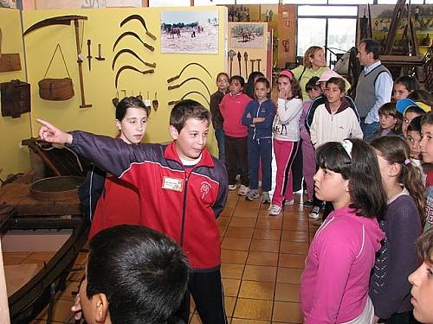
Register of Best safeguarding Practices
School museum of Pusol (Spain)
Guided by teachers, children explore the rich heritage of Elche by working with tradition-bearers and documenting their heritage.
(c) 2010 Centre for Traditional Culture – School museum of Pujol
Notes:
http://www.unesco.org/culture/ich/index.php?lg=en&pg=00011&Art18=00306

Slide 13
Organs of the Convention
.
Intergovernmental Committee: 24 states members, implement the Convention.
General Assembly: sovereign body of the Convention. All States Parties are members.
UNESCO Secretariat assists in implementation of the Convention

Slide 14
Operational Directives
Guide implementation of the Convention
Include regulations and procedures for Lists and Fund
Prepared by Committee, approved by General Assembly
First set approved 2008; amended and enlarged 2010
.

Slide 15
Intangible Heritage Fund
Article 25
Mainly supports safeguarding, inventory making, capacity building
States Parties contribute to the Fund
Some States make additional contributions
States Parties may request financial assistance, singly or jointly
Few requests for assistance received so far
.

Slide 16
Exercise: Obligations of States Parties
In Articles 11-15 and 26-29 of the Convention, please identify where it says
- States Parties shall ...?
- States Parties shall endeavour to ...?

Slide 17
Obligations of States Parties
Safeguard ICH on its territory (Article 11(a))
Ensure community participation in identifying and safeguarding (Article 11(b), 15)
Identify, define and inventory ICH in its territory (Article12.1)
Contribute to the ICH Fund (Article 26)
Report to the Committee (Article 29)

Slide 18
Benefits of implementation (1)
.
Better safeguarding of the ICH nationally, contributing to:
Well-being of communities;
Respect and understanding between communities;
Enhancement of cultural diversity, at both national and international levels; and
Sustainable development

Slide 19
Benefits of implementation (2)
.
International cooperation and assistance:
Sharing expertise and information internationally
Sharing good safeguarding practices
Accessing assistance from the Fund
Nominating elements
Participating in the organs of the Convention
Cooperating regionally and internationally on shared heritage

Slide 20
Points to remember...
.
The Convention aims to:
Safeguard the ICH
Promote cultural diversity, human creativity, mutual understanding, and international cooperation
Communities participate in the definition, enactment, transmission and safeguarding of their ICH

Slide 21
Points to remember...
.
The Convention:
Is run by an Intergovernmental Committee, controlled by a General Assembly, both assisted by the UNESCO secretariat
Has Operational Directives, a Fund, two Lists and a Register of Best Practices
Ratification imposes some obligations on States Parties
Implementation brings benefits to States Parties, communities concerned and other stakeholders

